Slide 1


HOW POPULAR ARE SPOTIFY PLAYLISTS?
Analysis with Machine Learning Models
Predictive Analytics | Team 2: Data Alchemists
In association with

Slide 2
INTRODUCTION
Objective
Predict the popularity of Spotify playlists, as measured by the number of followers, using ML models.
High-level Approach
Thorough data cleaning, usage of predictive models, and insights gathering. Linear regression is the benchmark model.

Slide 3
Dataset
Pre-Processing
Key Features:
Playlist Name
Collaborative
Playlist ID
Modified At
Number of Albums
Number of Tracks
Number of Edits
Duration of Tracks
Number of Artists
Number of Followers
1. Missing Values
a. Number of Edits
b. Duration of Tracks
c. Number of Artists
2. Data Type Conversions
3.Normalization/Standardization

Slide 4
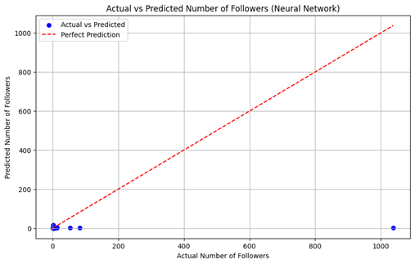
Models and Evaluation Metrics
Linear Regression
Decision Tree Regression
K-Nearest Neighbors (KNN) Regression
Support Vector Regression (SVR)
Neural Network Regression
MSE, MAE, R²
Provides a well-rounded analysis of model’s accuracy

Slide 5
Results
We’ve decided to omit explaining each individual result (5 models x 3 evaluation metrics) and concisely summarized our results.
Model performance was moderately accurate; bogged down by R²
SVR showed lowest MAE; closest prediction to follower counts
Simpler models LR and SVR outperformed the others (lower MSE, MAE) but struggled with ‘goodness of fit’

Slide 6
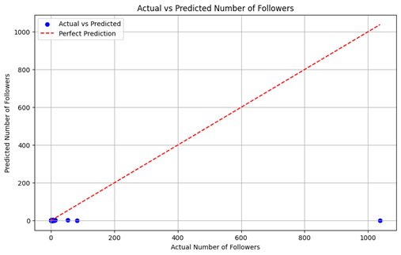
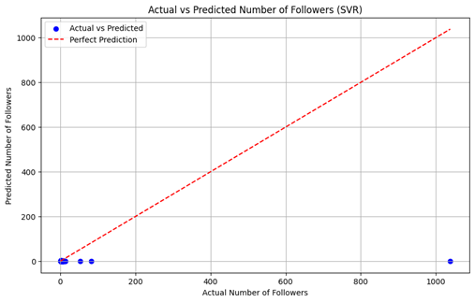
Insights
SVR had the closest predictions to actual follower count for each feature
However, the consensus on these models is that none were particularly outstanding at accurately representing factors that affected playlist popularity (i.e. R²)

Slide 7
Recommendation and Future work
As per our objective of predicting the popularity of Spotify playlists:
We suggest using the Support Vector Regression Model because it had the closest predictions to actual follower counts and lower MSE and MAE.
Given the limited scope of exploratory data analysis with just the models, what would future work entail?
1. Playlist Similarity and recommendation system
2. Playlist Content Analysis
3. User Engagement Prediction
4. User Segmentation based on Playlist Preferences

